Slide 1
CES 361
Fundamentals of Software Testing
Session 4
Equivalence Partitioning

Slide 2
Takeaways from Project 1
Small sample sizes are not sufficient to test randomness
    20 is not enough! Looks random ≠ Is random
Some test cases focused too heavily on the trivial cases
    E.g., 5 test cases rolling a few dice, 1 test case with a distribution
Some struggled to tell Alice what “random” should look like
    E.g., Every value appears and the value appearing most appears on more than
    10 times as much as the value appearing least
Not everyone’s program worked!
Some folks had rather ill-defined requirements
    E.g., The program shall roll a given number of 6-sided dice randomly
    E.g., The program must be able to handle errors
Many had dice value distributions, but not sum distributions
Most tested for distributions; very few mentioned independence
Always put code at the very end (not the summary notes)
Most of this should be word-processed, but it’s okay to hand-write results

Slide 3
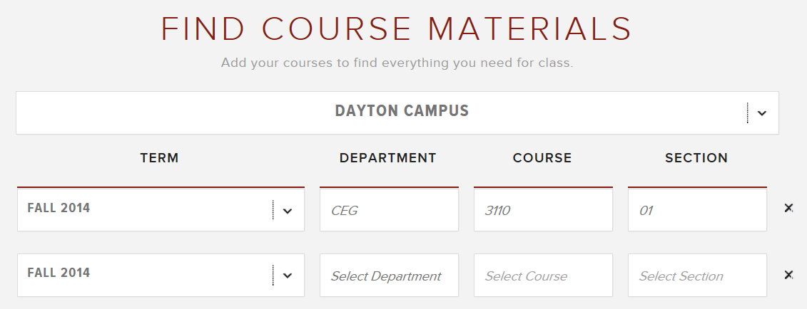
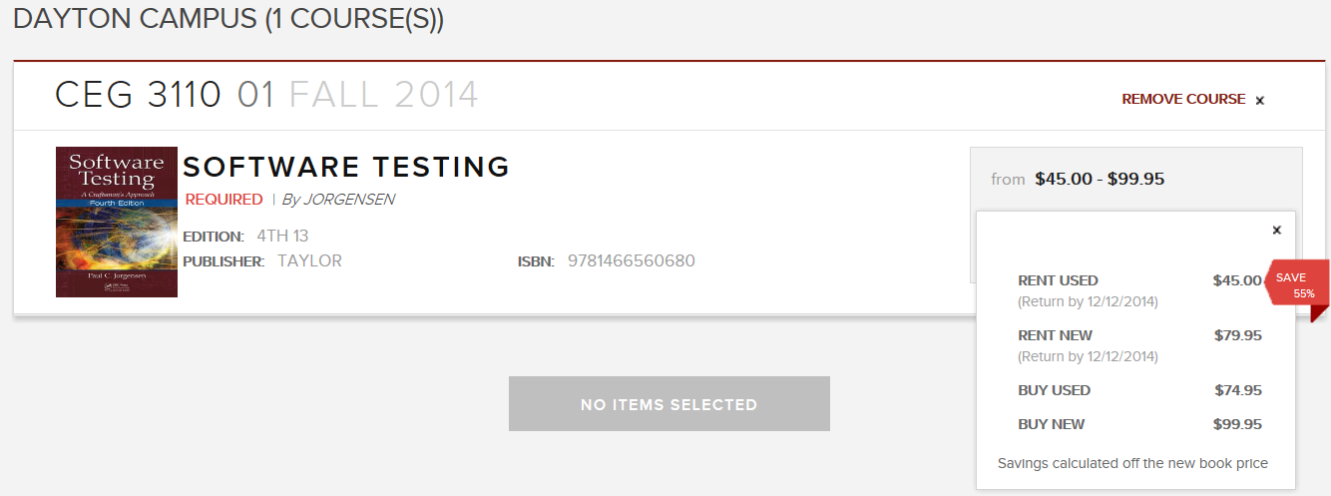
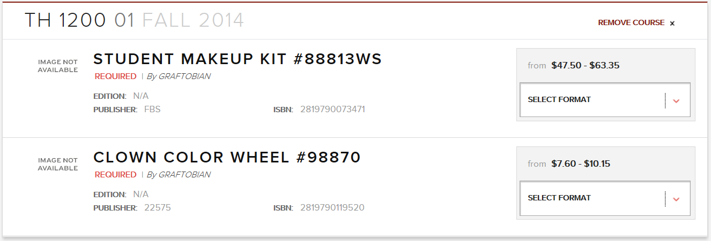
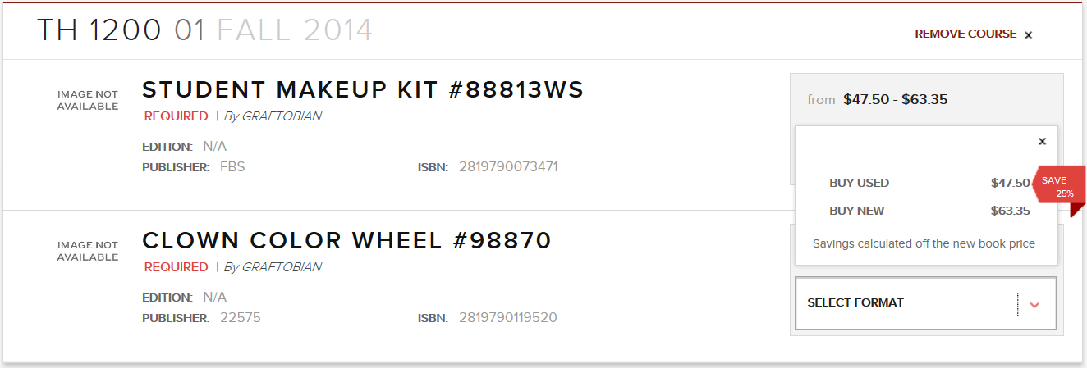
Glitch of the Day

Slide 4

HW Assignment 1
Password Checker Program
For this assignment, assume passwords must adhere to the following standard:
The system shall reject any new password that:
does not have a minimum of 2 upper-case letters
2) does not have a minimum of 2 lower-case letters
3) does not have a minimum of 2 numerals, 0-9
4) does not have a minimum of 2 special characters, which include the following:
Also, a new password shall be rejected if it:
5) is not at least 9 characters long, or is more than 24 characters long
6) contains one or more blank spaces.
Let’s see... how many different passwords
are there?
Software
Testing

Slide 5
Question About our Testing Space
Assume a 9-character password is in the form aaAA$$99__
How many valid passwords can we form?
26x26x26x26x28x28x100x90 = 3,224,422,656,000
How many ways can we arrange a 9-character password?
9! = 362880
9! x 3.2 trillion = 1.17 x 10¹⁸
This simply an approximate number of valid 9-character passwords.
26
26
26
26
28
28
10
10
x90
How many possible first characters?

Slide 6

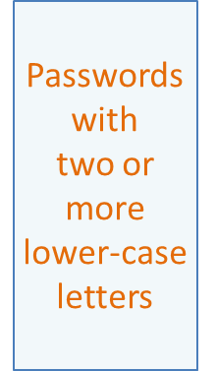
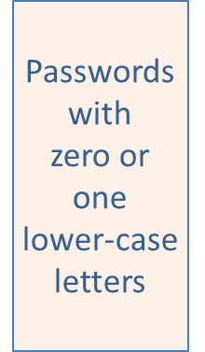


What is equivalence partitioning?
Password Security Requirements:
Passwords must be at least 9 characters long.
2. Passwords cannot contain blank spaces.
3. Each password must contain:
At least two upper-case letters
At least two lower-case letters
At least two numbers
At least two special characters
2
Passwords with
two or more
upper-case letters
2+2=4
Passwords with
zero or one
upper-case letters
4+4 =8
Passwords
with 2+
upper-case
but <2
lower-case
Passwords
with 2+
upper-case
and 2+
lower-case
4+8=12
Passwords
with <2
upper-case
and <2
lower-case
Passwords
with <2
upper-case
but 2+
lower-case
There are two kinds of passwords in the world...
How many kinds of passwords are there?
Software
Testing
Question: What are we missing?

Slide 7
Equivalence Partitions
Less than 9
characters
At least 9 and not more than 24 characters
More than 24 characters
Contains at least one
blank space
Contains no
blank spaces
Contains insufficient
lower case
Contains sufficient
lower case
Contains insufficient
numerals
Contains sufficient
numerals
Contains insufficient
upper case
Contains sufficient
upper case
Contains insufficient
special chars
Contains sufficient
special chars

Slide 8
One more issue to deal with...
New passwords cannot be similar to any
of the user’s three previous passwords.
Question: What is “similar to”?
5-character substring (forward or backward)
independent of letter case (in other words,
“aBCd&” and “AbCD&” would count as a
matching 5-character substring).

Slide 9
Questions?

Slide 10
This slide intentionally left blank

